Slide 1
Chapter 5:
System Software: Operating Systems and Utility Programs

Slide 2
Learning Objectives
Understand the difference between system software and application software.
Explain the different functions of an operating system and discuss some ways that operating systems can enhance processing efficiency.
List several ways in which operating systems differ from one another.
Name today’s most widely used operating systems for personal computers and servers.

Slide 3
Learning Objectives
State several devices other than personal computers and servers that require an operating system and list one possible operating system for each type of device.
Discuss the role of utility programs and outline several tasks these programs perform.
Describe what the operating systems of the future might be like.

Slide 4
Overview
This chapter covers:
  Differences between system software and application software
  Functions of and differences among operating systems
  Various types of operating systems
  Functions of and various types of utility programs
  A look at the possible future of operating systems

Slide 5
System Software and Application Software
System software: The operating system and utility programs that control a computer system and allow you to use your computer
  Enables the boot process, launches applications, transfers files, controls hardware configuration, manages hard drive, and protects from unauthorized use
Application software: Programs that allow a user to perform specific tasks on a computer
  Word processing, playing a game, preparing taxes, browsing the Web, and so forth

Slide 6
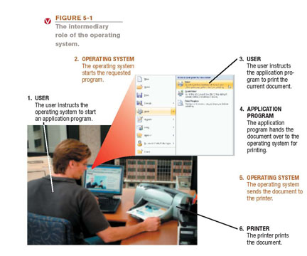
The Operating System
Operating system: A collection of programs that manage and coordinate the activities taking place within a computer system
  Acts as an
  intermediary
  between the
  user and the
  computer

Slide 7
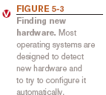

Functions of an Operating System
Interfacing with users (typically via a GUI)
Booting the computer
  Kernel is loaded into memory
  Processes are started
  msconfig used to control startup of processes
Configuring devices
  Device drivers are often needed; can be reinstalled if needed
  Plug and Play devices are recognized
  automatically

Slide 8
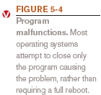
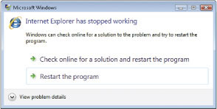
Functions of an Operating System
Managing resources and jobs
  Makes resources available to devices
  Monitors for problems
  Scheduling routines
File management
  Keeps track of files stored
  on computer
  Hierarchical format
Security
  Passwords
  Biometric characteristics
  Firewalls

Slide 9
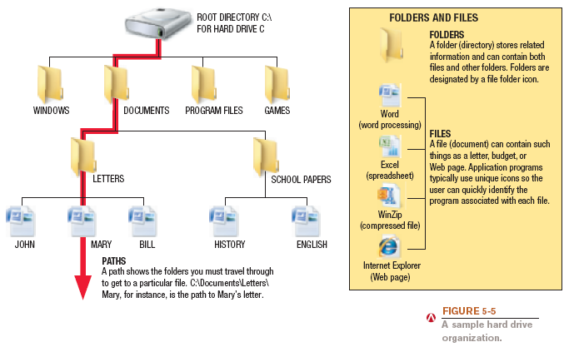
File Management

Slide 10
Processing Techniques for
Increased Efficiency
Multitasking: The ability of an operating system to have more than one program (task) open at one time
    CPU rotates between tasks
    Switching is done quickly
    Appears as though all programs executing at the same time
Multithreading: The ability to rotate between multiple threads so that processing is completed faster and more efficiently
    Thread: Sequence of instructions within a program that is independent of other threads
Notes:
Multithreading enables the operating system to run multiple tasks or threads concurrently, improving the overall performance and responsiveness of the system. For example, a web browser can use multithreading to download multiple files at the same time, while also allowing the user to interact with the interface.

Slide 11
Processing Techniques for
Increased Efficiency
Multiprocessing and parallel processing: Multiple processors (or multiple cores) are used in one computer system to perform work more efficiently
  Simultaneous processing: Performs tasks at the same time
  Multiprocessing: Each CPU (or core) typically works on a different job
    Used with personal computers with multi-core processors
  Parallel processing: CPUs or cores typically works together to complete one job more quickly
    Used with servers and mainframes

Slide 12
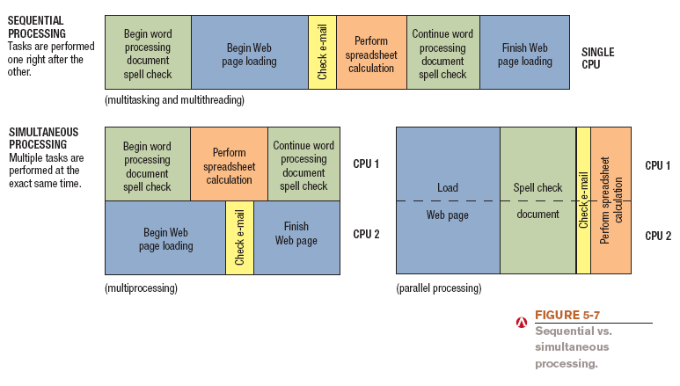
Processing Techniques for
Increased Efficiency

Slide 13
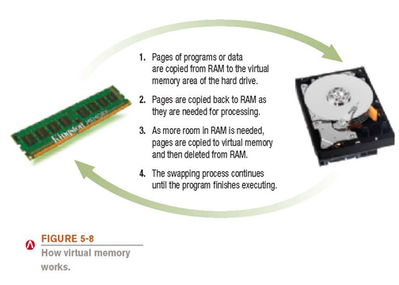
Processing Techniques for
Increased Efficiency
Memory management: Optimizing the use of main memory (RAM)
  Virtual memory: Memory-management technique that uses hard drive space as additional RAM

Slide 14
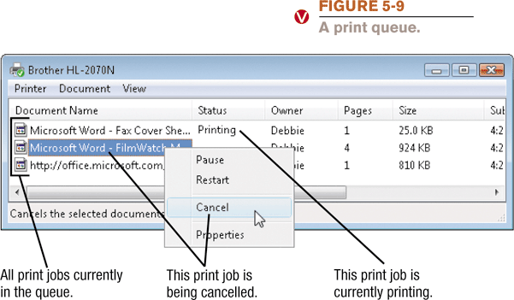
Processing Techniques for
Increased Efficiency
Buffering and spooling: Used with printers and other peripheral devices
    Buffer: area in RAM or on the hard drive designated to hold input and output on their way in or out of the system
    Spooling: placing items in a buffer so they can be retrieved by the appropriate device when needed

Slide 15
Quick Quiz
1. Which of the following processing techniques allows a computer to work with more than one program at a time?
  a. Parallel processing
  b. Virtual memory
  c. Multitasking
2. True or False: Most operating systems today use a command line interface.
3. _____________ is the task included with operating systems that allows to you keep track of the files stored on a PC.
Answers:
1) c; 2) False; 3) File management

Slide 16
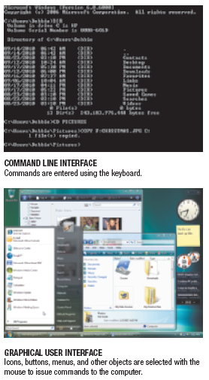

Differences Among Operating Systems
Command line vs. graphical user
interface (GUI)
  Most operating systems use
  GUI today

Slide 17
Differences Among Operating Systems
Personal vs. server operating system
  Personal operating system: designed to be installed on a single computer
  Server operating system: designed to be installed on a network server
    Client computers still use a personal operating system
    Server operating system controls access to network resources
  Many operating systems come in both versions
Mobile and embedded operating systems also exist

Slide 18
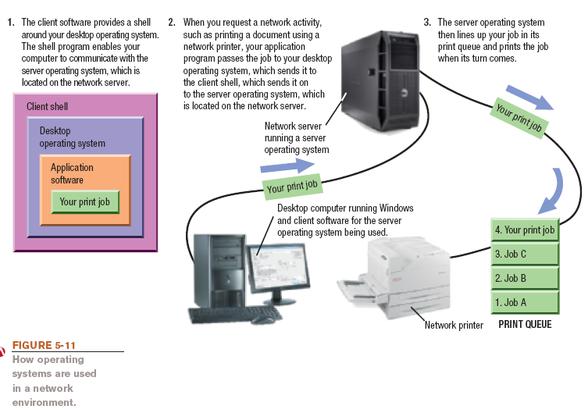
Server Operating Systems

Slide 19
Differences Among Operating Systems
Types of processors supported
  Desktop, mobile, server, etc.
Number of processors
32-bit or 64-bit CPUs
Support for other technologies
  New types of buses
  Virtualization
  Power-saving features
  Touch and gesture input

Slide 20
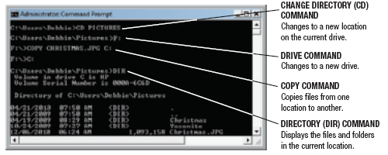
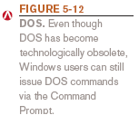
Operating Systems for
Personal Computers and Servers
DOS: Disk Operating System
  PC-DOS: Created originally for IBM microcomputers
  MS-DOS: used with IBM-compatible computers
  DOS traditionally used a command-line interface
  Can enter DOS commands in Windows

Slide 21
Windows
Windows: The predominate personal operating system developed by Microsoft Corporation
  Windows 1.0 through Windows 3.x: Operating environments for DOS
  Windows 95 and Windows 98: Used a similar GUI to the one used with Windows 3.x
  Windows NT (New Technology): first 32-bit version of Windows designed for high-end workstations and servers
  Windows Me (Millennium Edition): designed for home computers, improved home networking and a shared Internet connection

Slide 22
Windows
  Windows 2000: replaced Windows NT; was geared towards high-end business workstations and servers, support for wireless devices
  Windows XP: Replaced both Windows 2000 and Windows Me
    Improved photo, video, and music editing and sharing
    Improved networking capabilities
    Support for handwriting and voice input
    Large user base, MS will support until 2014

Slide 23
Windows
  Windows Vista: Replaced Windows XP
    Features the Aero visual interface
      Transparency and animations
      Live Thumbnails
    Additional features
      Sidebar, Instant Search, etc.
    The Vista Start menu is more streamlined
    Improved networking and multimedia
    Built-in security features
    Hardware requirements for Vista have increased over earlier versions of Windows

Slide 24
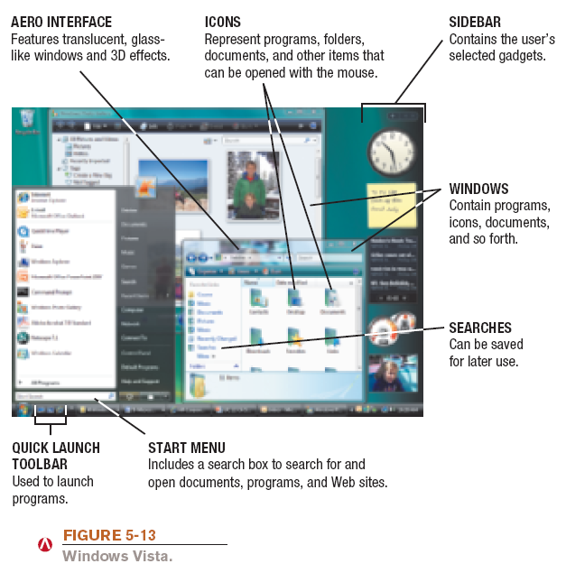
Windows Vista

Slide 25
Windows
  Windows 7: Newest version of Windows released Oct. 2009
    32-bit and 64-bit versions in four editions
      Home Premium (primary version for home users)
      Professional (primary version for businesses)
    Starts up and responds faster than Vista
    Will run well on netbooks, unlike Vista
    Device Stage for all connected devices
    Improved home networking (HomeGroup, etc.)
    Jump lists, gadgets, etc.

Slide 26
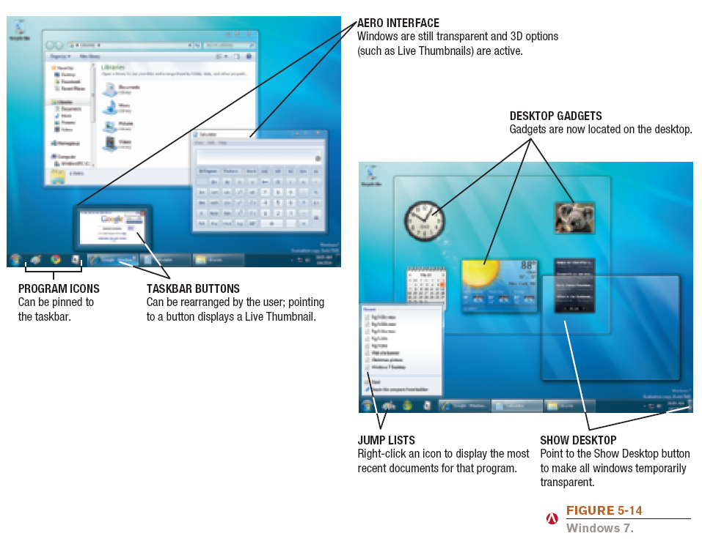
Windows 7

Slide 27
Windows
  Windows Server: Server version of Windows
    Windows Server 2008: Most recent version
    Includes a variety of services
      Web platform
      Support for virtualization
      New security tools
      Streamlined management tools
  Windows Home Server: New operating system based on Windows Server
    Provides services for a home network
    Can back up all devices on the network automatically

Slide 28
Mac OS
Mac OS: Proprietary operating system for computers made by Apple Corporation
  Based on the UNIX operating system; originally set the standard for graphical user interfaces
  Mac OS X Snow Leopard: Most recent personal version
  Includes:
    Safari Web browser
    New features like Time Machine, Stacks, Quick Look, Boot Camp, etc.
    More responsive than previous versions

Slide 29
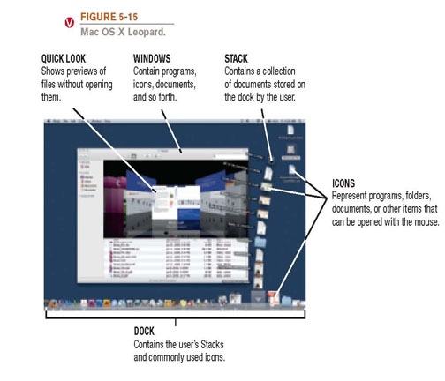
Mac OS

Slide 30
UNIX
UNIX: Operating system developed in the late 1960s for midrange servers
  Multiuser, multitasking operating system
  More expensive, requires a higher level of technical knowledge; tends to be harder to install, maintain, and upgrade
  “UNIX” initially referred to the original UNIX operating system, now refers to a group of similar operating systems based on UNIX
  Single UNIX Specification: A standardized UNIX environment

Slide 31
Linux
Linux: Version (flavor) of UNIX available without charge over the Internet
  Increasingly being used with personal computers, servers, mainframes, and supercomputers
  Is open-source software: has been collaboratively modified by volunteer programmers all over the world
  Originally used a command line interface, most recent versions use a GUI
  Strong support from mainstream companies, such as Sun, IBM, HP, and Novell
  Much less expensive than Windows or Mac OS

Slide 32
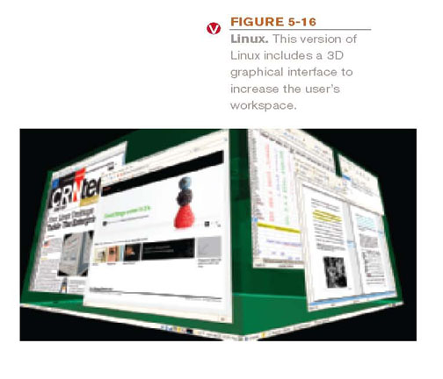
Linux

Slide 33
Quick Quiz
1. Which of the following is the most recent personal version of Windows?
  a. Windows 7
  b. Windows Leopard
  c. Windows XP
2. True or False: Linux is an open source operating system available for free via the Internet.
3. The operating system most commonly used on Apple personal computers is ______________________.
Answers:
1) a; 2) True; 3) Mac OS

Slide 34
Operating Systems for
Mobile Phones and Other Devices
Windows Mobile: Designed for mobile phones
  Look and feel of desktop versions
  Current version 6.1, next version to be called Microsoft Phone.
Windows Embedded: Designed for consumer and industrial devices that are not perosonal computers
  Cash register, GPS devices, ATMs, medical devices and robots.
  Windows Automotive and Microsoft Auto for cars
    Ford Sync
Android: Linux based OS developed by Open Handset Alliance (including Google)

Slide 35

Online Video
“A Tour of the T-Mobile G1 Android Mobile Phone”
(click below to start video)
Courtesy of Google Inc.
Reminder: The complete set of online videos and video podcasts are available at: www.cengage.com/computerconcepts/np/uc13

Slide 36
Operating Systems for
Mobile Phones and Other Devices
iPhone OS: Designed for Apple Mobile phones and mobile devices.
BlackBerry Operating System: Designed for BlackBerry devices
Palm OS and Palm webOS: Designed for Palm devices
Symbian OS: Designed for use with smart phones
Embedded Linux: Used with mobile phones, GPS devices, and other mobile devices

Slide 37
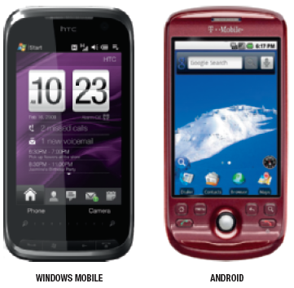
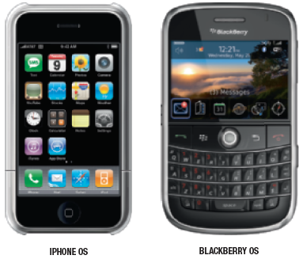

Operating Systems for
Mobile Phones and Other Devices

Slide 38
Operating Systems for
Larger Computers
Larger computers sometimes use operating systems designed solely for that type of system
IBM’s z/OS and i/5OS operating systems are designed for their servers and mainframes
Windows, UNIX, and Linux are also used with both mainframes and supercomputers
Often a group of Linux computers are linked together to form what is referred to as a Linux supercomputing cluster

Slide 39

Utility Programs
Utility program: Software that performs a specific task, usually related to managing or maintaining the computer system
Many utilities are built into operating systems (for finding files, viewing images, backing up files, etc.)
Utilities are also available as stand-alone products and as suites

Slide 40
File Management Programs
File management programs: Enable the user to perform file management tasks, such as:
  Looking at the contents of a storage medium
  Copying, moving, and renaming files and folders
  Deleting files and folders
  File management program in Windows is Windows Explorer

Slide 41
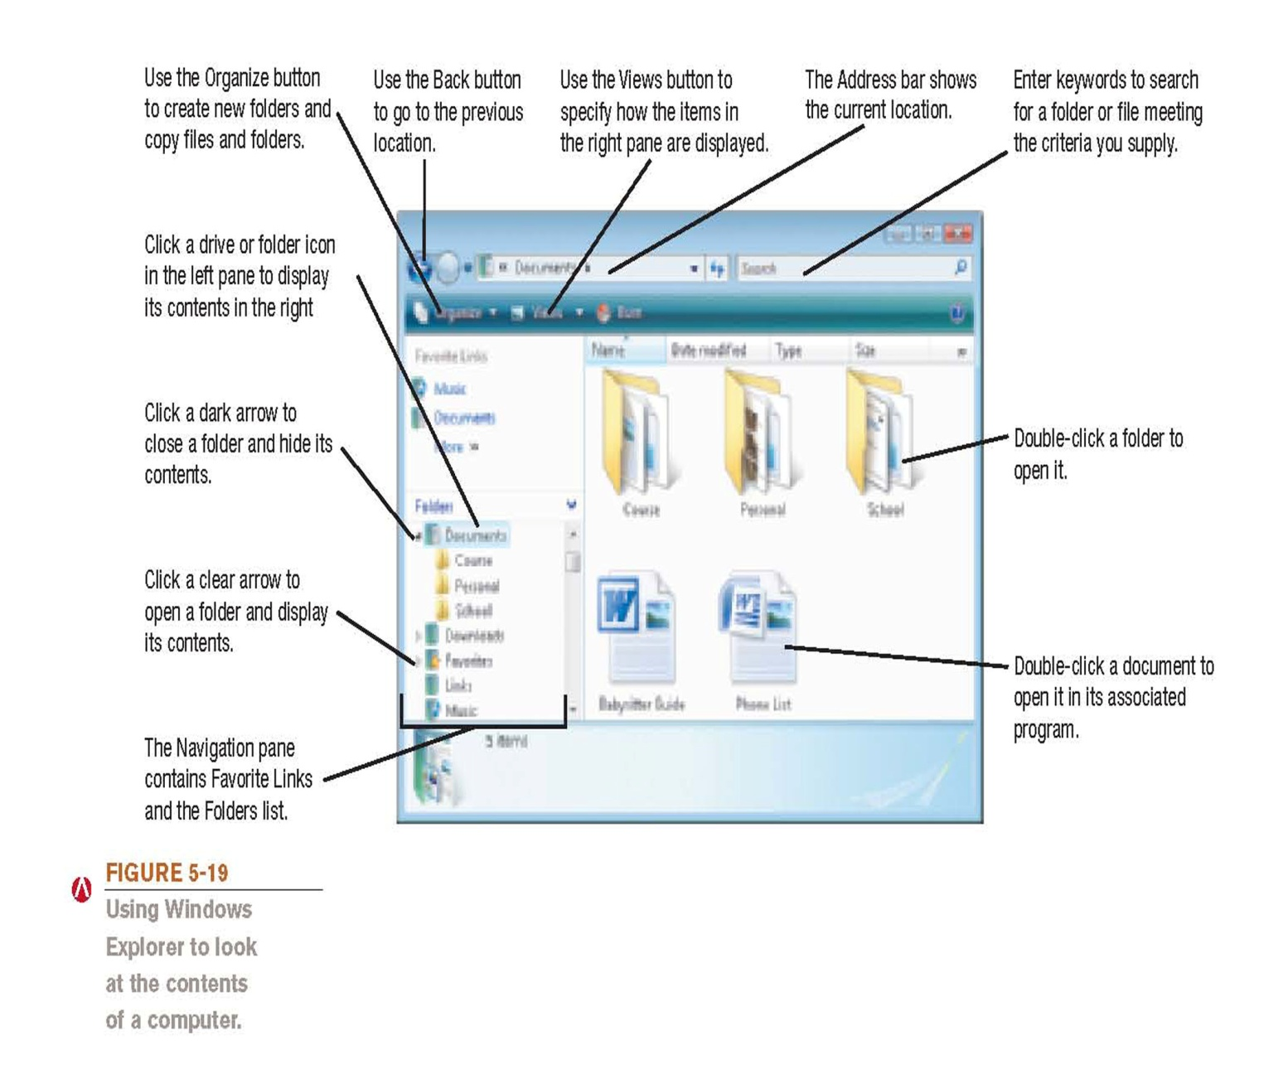
Using Windows Explorer

Slide 42
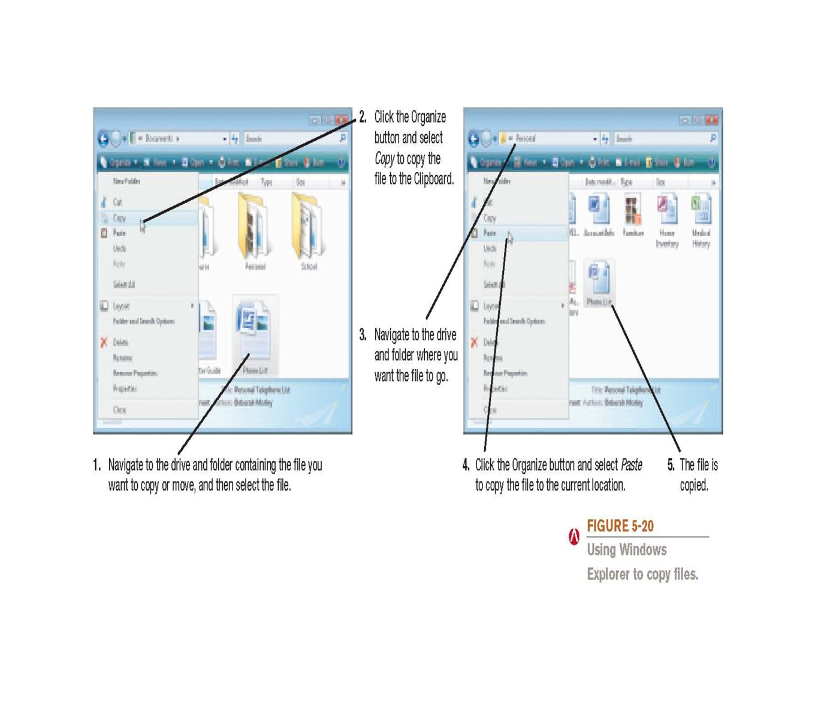
Using Windows Explorer

Slide 43
Utility Programs
Search tools: Designed to search for files on the user’s hard drive
  Windows includes search tools
Diagnostic programs: Evaluate your system and make recommendations for fixing any errors found
Disk management programs: Diagnose and repair problems related to your hard drive
Uninstall utilities: Remove programs from your hard drive without leaving bits and pieces behind
    Important to properly uninstall programs, not just delete them

Slide 44
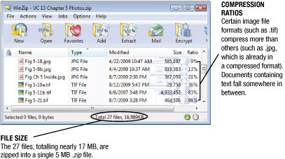
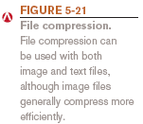
Utility Programs
Clean up utilities: Delete temporary files
File compression programs: Reduce the size of files so they take up less storage space on a storage medium or can be transmitted faster over the Internet
  Both zip and unzip files
  WinZip (Windows users) and Stuffit (Mac users)

Slide 45
Utility Programs
Backup and recovery utilities: Make the backup and restoration process easier
  Backup: Duplicate copy of data or other computer content
  Good backup procedures are critical for businesses
  Individuals should back up important documents,
  e-mail, photos, home video, etc.
  Store backup data on a CD or DVD, second hard drive, flash memory drive, or upload to the Internet
  Back up your entire computer once all programs have been installed, so your system can be restored to that configuration.

Slide 46
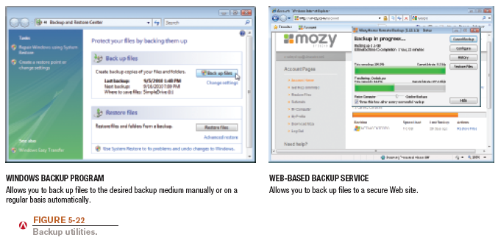
Backup Programs

Slide 47
Utility Programs
Security programs: Protect computers and users
  Antivirus programs
  Antispyware programs
  Firewalls
  Many are included in Windows and other operating systems
  Discussed in detail in Chapter 9

Slide 48
The Future of Operating Systems
Will continue to become more user-friendly
Will eventually be driven primarily by a voice interface
Likely to continue to become more stable and self-healing
Will likely continue to include improved security features and to support multiple processors and other technological improvements
May be used primarily to access software available through the Internet or other networks

Slide 49
Quick Quiz
1. Which of the following is the type of utility program used to make a file smaller for transfer over the Internet?
  a. Uninstall program
  b. Antivirus program
  c. File compression program
2. True or False: A file management program can be used to see the files located on a storage medium.
3. A(n) ______________________ is a duplicate copy of one or more files that can be used if there is a problem with the original files.
Answers:
1) c; 2) True; 3) backup

Slide 50
Summary
System Software vs. Application Software
The Operating System
Operating Systems for Personal Computers and Servers
Operating Systems for Mobile Phones and Other Devices
Operating Systems for Larger Computers
Utility Programs
The Future of Operating Systems

